Slide 1
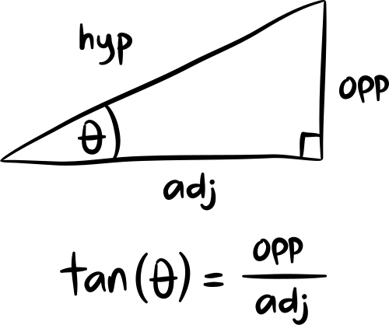
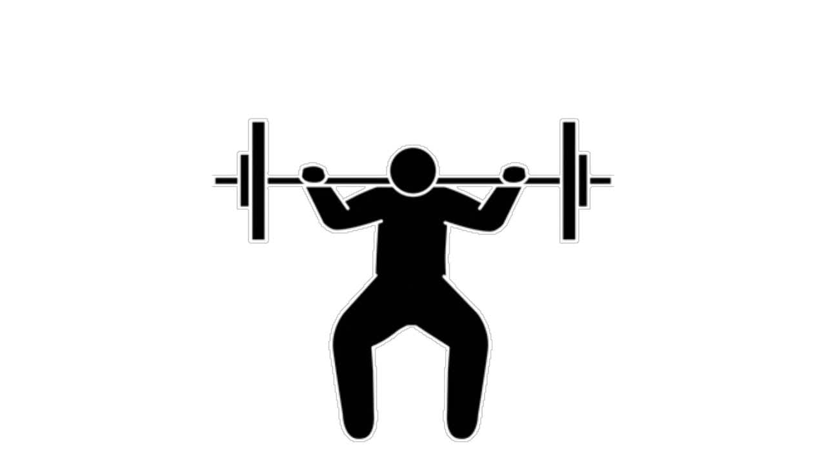

TRIGONOMETRY
Trigonometry explores the relationships between the angles and sides of triangles. Its origins trace back to ancient civilizations, where it was used for studying the heavens and developing early astronomical models. Today, trigonometry is crucial in fields like physics, engineering, and computer graphics.
Mastering the basic trigonometric functions—sine, cosine, and tangent—unlocks numerous applications. Whether calculating the height of a mountain or designing computer simulations, trigonometry provides essential tools. Its principles underpin wave analysis, signal processing, and even music, making it a fundamental part of mathematics.
WHERE SHAPES MEET STRATEGY
A SIMPLE GUIDE TO TAN(Θ) IN ACTION

Slide 2




Trigonometry explores the relationships between the angles and sides of triangles. Its origins trace back to ancient civilizations, where it was used for studying the heavens and developing early astronomical models. Today, trigonometry is crucial in fields like physics, engineering, and computer graphics.
YEAR 7 - MATH
Triangles and Angles
M GANESH KUMAR
INSPIRED BY

